Slide 1

Environmental and economic assessment of the DECISIVE demonstration site
Elisavet Angouria-Tsorochidou

Slide 2
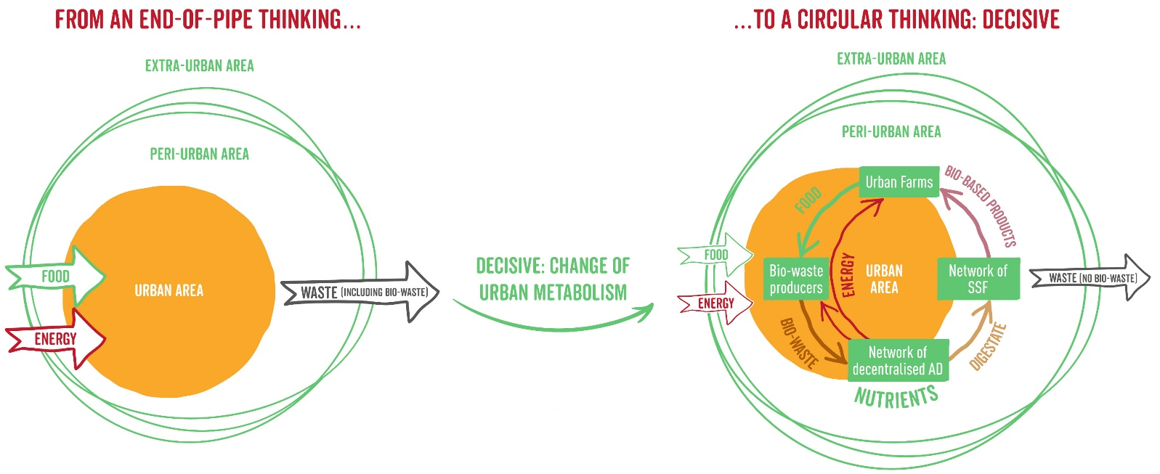
The system
A decentralized scheme for innovative valorization of urban biowaste management

Slide 3
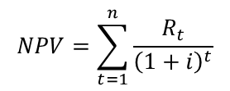
Methods
Environmental assessment → Life cycle assessment… or LCA is a methodology for assessing environmental impacts associated with all the stages of the life cycle of a system.
Economic assessment → Net present value… or NPV is a methodology for assessing the economic desirability of a project.
$$NPV=\sum_{t=1}^{n}{\frac{R_{t}}{{\left(1+i\right)}^{t}}}$$

Slide 4
Data requirements
Layer 1
Infrastructure
Container & Equipment
Layer 2
Background processes
Electricity & Water & Materials/Chemicals & Trucks & Bicycles
Layer 3
Foreground processes
Process emissions

Slide 5
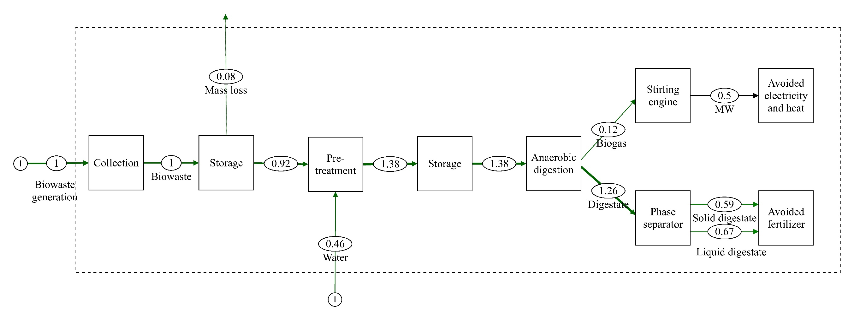
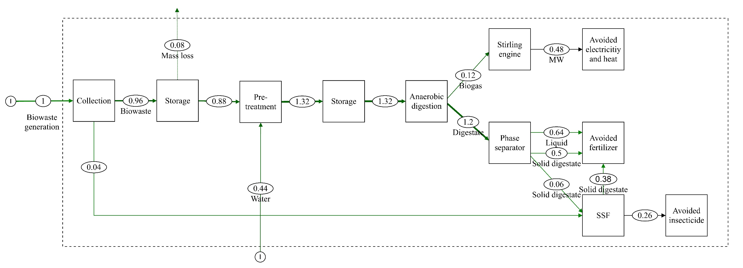
Modelled scenarios- Part I
Goal: Comparison of the energy centered system with micro anaerobic digestion (mAD) and the biowaste-based biorefinery with solid state fermentation (SSF)
Scenario 1
Scenario 2

Slide 6
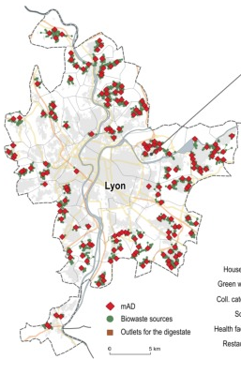
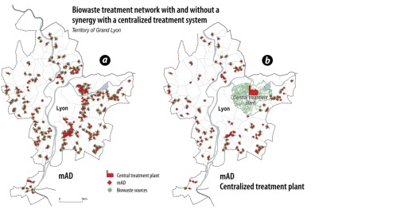
Modelled scenarios- Part II
Goal: Comparison of the energy centered system with micro anaerobic digestion (mAD) and the biowaste-based biorefinery with solid state fermentation (SSF)
Scenario 3: 10%
Scenario 4: 20%
Scenario 5: 20% + a centralized plant
Thiriet et al. (2020) Optimization method to construct micro-anaerobic digesters networks for decentralized biowaste treatment in urban and peri-urban areas

Slide 7
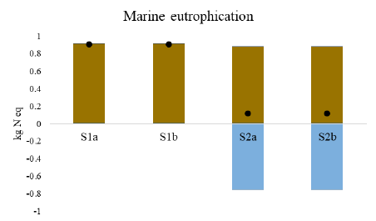
Results - LCA
Scenario 1 & 2

Slide 8
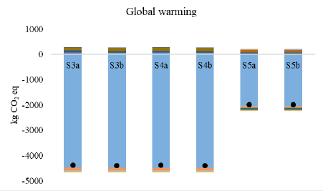
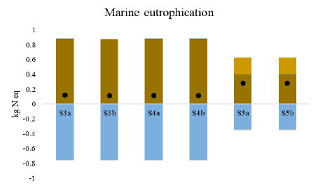
Results - LCA
Scenario 3 & 4 & 5

Slide 9
Results - NPV

Slide 10
Highlights
The study assessed the environmental and economic assessment of the DECISIVE pilot plant in Lyon.
The addition of the SSF for the production of bio-pesticides creates a carbon negative system, due to the avoided production of conventional products.
The system is sensitive to the choice of the substituted insecticide.
The biorefinery network can be economically profitable.
Collection with bikes contributes to a low-carbon system but increases the economic costs.

Slide 11

Elisavet Angouria-Tsorochidou
PhD Fellow
Aarhus University
Department of Environmental Science
elan@envs.au.dk

