Slide 1
Demonstration of the DECISIVE concept
A circular bioeconomy at local level
Anne Trémier, INRAE, France

Slide 2
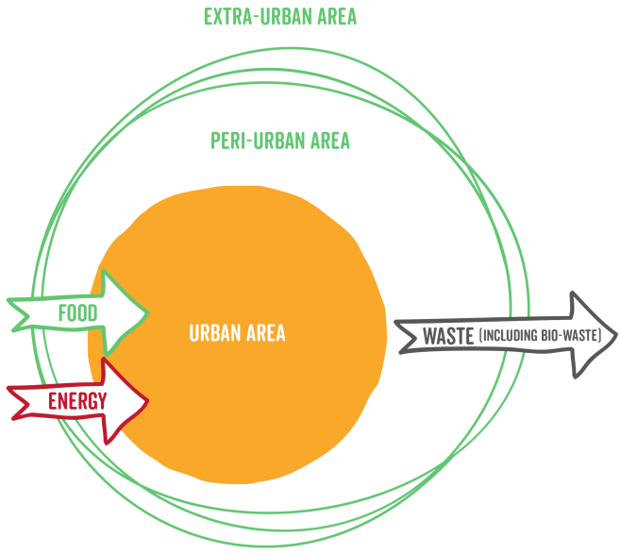
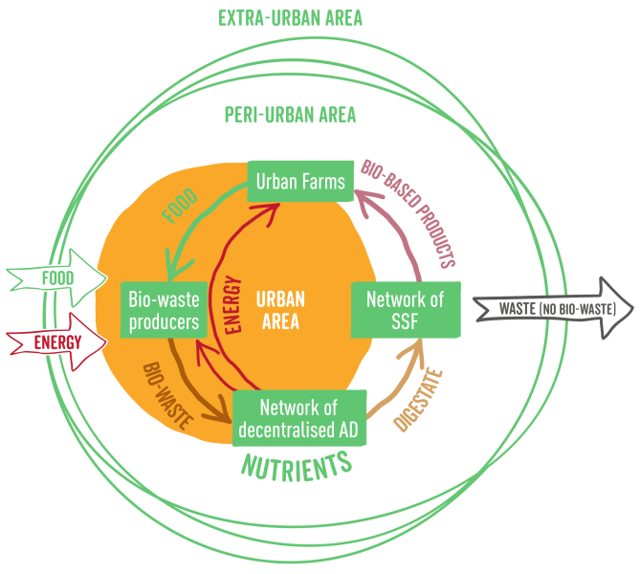
Reminder about the DECISIVE concept
DECISIVE: change of urban metabolism

Slide 3
Demonstrating the concept
Test the feasability of the installation of the decentralised waste valorization circuit
Test the technical performance of the micro-processes
Get some data to assess the economic and environmental performances

Slide 4
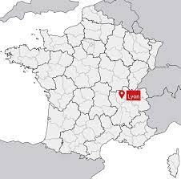
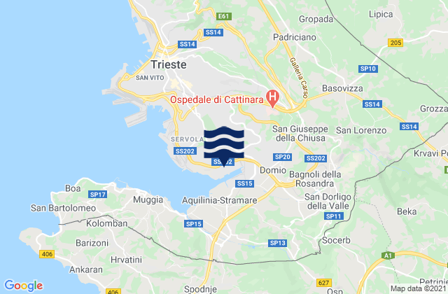
Demonstration sites
Lyon (France)
3rd French city; center of the 2nd French urban area
No biowaste separate management (at the beginning of the project)
reFARMERS – a urban farm project
Dolina, Italy
Community far from waste management solutions in the area
Household bio-waste + restaurants
Link with local agriculture
Webinar 4

