Slide 1
The use of DST for Bellaterra university case
2nd DECISIVE Webinar - The DST
11st June 2021, on-line
Fundació ENT
Rosaria Chifari

Slide 2
AGENDA
Objective
Baseline/Alternative scenario diagrams
Waste process libraries to build
Data needed for the DST
Data gathering steps
….
….

Slide 3
Objective
Building scenarios for the Bellaterra University Campus in the DST to compare results
Dentralized biowaste management system
“INNOVATIVE” SCENARIO
DECISIVE systems
(mAD+ Stirling motor)
“BASELINE” SCENARIO
Centralized biowaste management system

Slide 4
Baseline scenario diagram
GENERATION
COLLECTION
TREATMENT
FINAL DESTINATION
Thermal Energy
Bellaterra Waste management system: Baseline
SOURCE SEPARATION
PRE TREATMENT
Electricity
CHP
UAB
University residence
TRANSPORT
Biogas
Bring scheme
Mechanical separation
Anaerobic Digestion
Compost
Agriculture
570 t/y
BIOWASTE
Digestate
47
Refuse
Incineration
MSW
Source Separation
Post-Composting
197 t/y
Refuse
487
RESIDUAL WASTE
Refuse
Landfill
Refuse
10 Restaurants in UAB University
Bring scheme
Mechanical separation
Biostabilization
Waste Water treatment
Maturation
234
RECYCLABLES
Recycling

Slide 5
Alternative scenario diagram
GENERATION
COLLECTION
TREATMENT
FINAL DESTINATION
Thermal Energy
Bellaterra Waste management system: Baseline
SOURCE SEPARATION
PRE TREATMENT
Electricity
change in collection system
Stirling
UAB
University residence
TRANSPORT
Biogas
Door to Door
Hygienization
Micro AD
Compost
Agriculture
570 t/y
BIOWASTE
Digestate
103
increase in SS BW
MSW
Source Separation
Liquid digestate
Refuse
Incineration
197 t/y
432
decrease in SS BW
RESIDUAL WASTE
Landfill
Refuse
10 Restaurants in UAB University
Door to
Door
Mechanical separation
Biostabilization
Waste Water treatment
Maturation
unvaried recyclables
234
RECYCLABLES
Recycling

Slide 6
Building inventories in the DST
To build scenarios we need to building Data /Inventories for the waste processes
Understanding which data we will need for the inventories in the DST
Looking for the available data
Introducing data/inventories in the DST

Slide 7
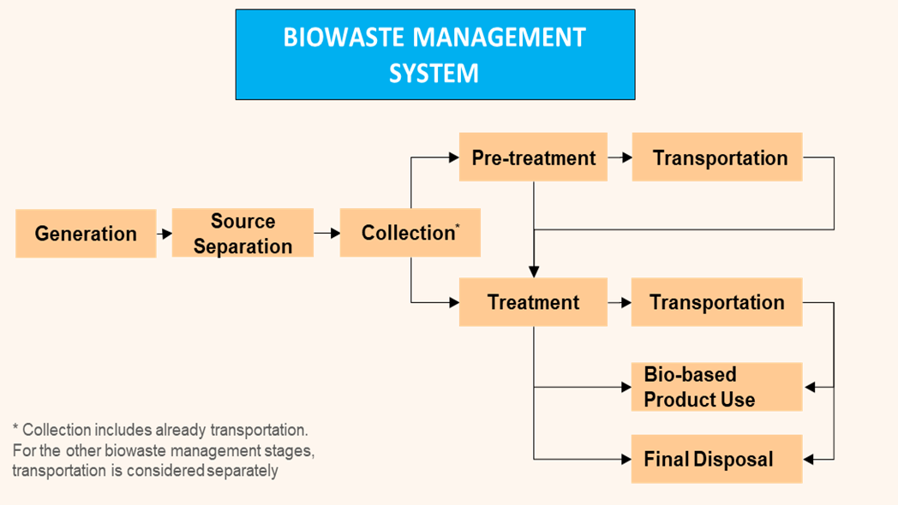
Which data are needed?
For each stage of the biowaste management system a list of data/ indicators will be needed for building inventories/libraries in the DST
Phases of BWMS in the DST

Slide 8
Generation
Waste type
Generation Unit
Type of source
Source size
Biowaste generation (t/unit)
Composition Biowaste (%)
Food Waste Composition
Notes:
Biowaste sources:
Type of Source (Household, Restaurant, Student residence, Hospital etc.)
Waste type (Biowaste, Source separated biowaste, Residual waste, Municipal Solid Waste, Other)
Generation Unit: it represents the unit of generation of biowaste. it can be: person, meal, bed, etc.
Mass flow parameters:
Source size (generation unit/year): it is the number of generation units (number of residents).
Biowaste Generation Amount (t/unit): amount of biowaste generated per Generation Unit.
Biowaste Composition: % of food waste, green waste, woody waste and other organic waste in the biowaste represented in this process.
Food waste Composition: % of avoidable and unavoidable FW

Slide 9
Source Separation
% Macro-impurities in SSBW
Waste Outputs:
SSBW
RW
Macro-impurities Composition (%)
Mass Flow Parameters
Material inputs
Mass distribution of the FW, GW, WW in RW and SSBW
Consumption of Bags, Buckets, Containers
Socio-economic aspects
Public and private space occupation,
Private generator time
Notes:
Waste Outputs. i.e. the biowaste generated in a source is separated in two streams: Source-Separated Biowaste (SSBW) and Residual Waste (RW)
Content of macro-impurities in the SSBW (in wet weight) and the Composition of such macro-impurities (glass, paper& cardboard, plastic, ferrous non Ferrous and other)
Material inputs: Amount of bags and or buckets, Amount of containers, Socio–economic aspects

Slide 10
Collection
Type of Collection
Inventories per tonne*km
the unit impacts of such inventories are later multiplied by the tonnes of waste times the distance along which the waste is transferred.
Material and energy inputs
Consumption
Trucks
Diesel
Socio-economic aspects
Worker
Public space
Notes:
the gathering of the waste from the different collection points and its transference to the waste facility collection process mainly includes trucks, combustible and labour associated with the waste transfer from sources to waste facilities.

Slide 11
Pretreatment
Waste Outputs:
Recyclables output
Refuse output
Biomass output
Mass Flow Parameters
distribution of the input biowaste sub-fractions
distribution of macro-impurities between three waste outputs
2nd DECISIVE Webinar: the DST • 11
Notes:
Direct emissions and material and energy inputs can be defined either per tonne of input

Slide 12
Treatment 1/2
AD wet batch & CHP + Composting
(ECO2- organic line )
Material and energy outputs
Biogas generated
Methane yield (%CH4)
Gas Composition
Material Outputs:
Solid refuse
Digestate
Compost
Energy output:
Electricity generated
Direct emissions
N2O, CH4, NH3

Slide 13
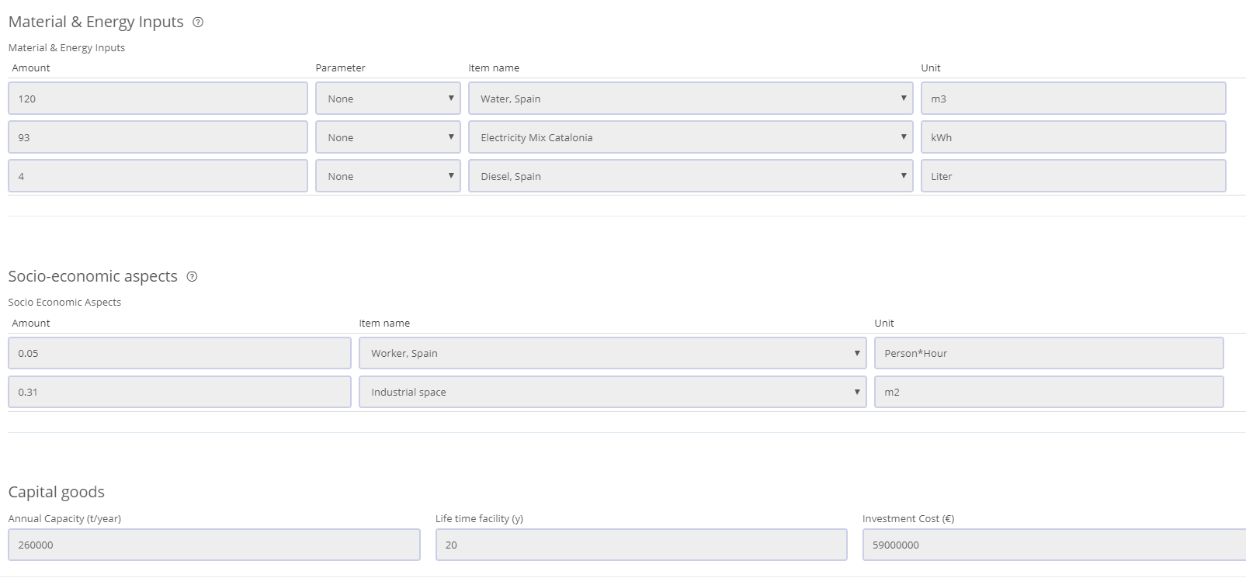
Treatment 2/2
AD wet batch & CHP + Composting
(ECO2- organic line )
Material and energy inputs
Consumption
Water
Electricity
Diesel
Material Outputs:
Solid refuse
Digestate
Compost
Socio-economic aspects
Worker
Public space
Capital goods
Annual Capacity
Lifetime facility
Investment cost

Slide 14
Transportation II
Truck of 34 t and
velocity: 59 km/h
Material and energy inputs
Inventories per tonne*km
Amount of trucks/t*km
Diesel consumption
Socio-economic aspects
Worker
Public space
Notes:
If Pre-treatment and Treatment occur in the same place, as in the case of waste from UAB sent to ECO2, this stage is not necessary and its definition has been skipped. If the Scenario does not include a Pre-treatment phase the Transportation stage is not necessary either, since the Collection phase can be used to bring the waste from the source to the first waste facility (in this case a Treatment facility).

Slide 15
Bio-based Product use
Use of Compost as fertilizer
Socio-economic aspects
Direct emissions
Agricultural land
N2O, CO2 bind
Material and energy inputs
Material and energy outputs
N, P, K mineral fertilizer
Diesel consumption

Slide 16
Final disposal
Incineration
Material and energy outputs
Residue outputs
Bottom ash treatment
Fly ash treatment
Direct emissions
HCl, Dioxins, As, Cd, PB, SO2, NOx, NH3, Hg
Energy outputs:
Electricity generated
Heat generated
Material and energy inputs
Diesel Consumption
Socio-economic aspects
Annual Capacity
Lifetime facility
Investment cost
Capital goods

Slide 17
Bellaterra – Baseline scenario
Summary Baseline scenario definition
Notes:
Añadir impr pantaglia

Slide 18
Bellaterra – Alternative scenario
Summary Alternative scenario definition
Notes:
Añadir impr pantaglia

Slide 19
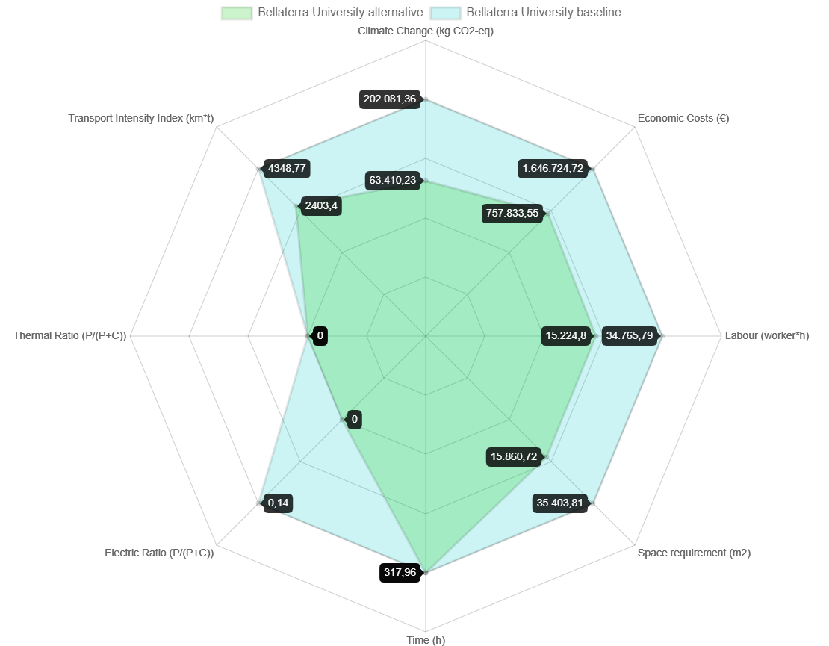
Scenario assessment results
The radars diagrams only wants to show how the DST works.
Inventories for DECISIVE system are provisional and need to be updated with real data
Notes:
Añadir impr pantaglia

Slide 20
THANK YOU FOR YOUR ATTENTION
Dr. Rosaria Chifari
Fundació ENT
rchifari@ent.cat

